Slide 1
UNA Events App
Final Project Paper
Professor Ronald Davis
May 2, 2025
Nhu Tran
Tuyet Nguyen
Thuan Nguyen

Slide 2
Table of Contents
I. Problem Statement and Feasibility Study
II. Brief Review of Requirements Analysis and Specification
III. Preliminary Design
IV. Detailed Design
V. Project Management
VI. Mockup of Prototype

Slide 3
I. Problem Statement and Feasibility Study
*Problem:
The University of North Alabama(UNA) currently has an events app that lacks basic functionality:
The application currently has a refresh button but is generally useless due to the lack of traffic the application sees.
The application is not visually appealing, and the application is very barebones.
The events application only shows UNA events that are held by the university, there are more events from student groups that get no spotlight on this application.
=> Due to the undesirability of the application, the app is rarely used to see events driving down the number of attendees.
*Idea:
Developing a new events app for UNA could be an opportunity that sees more students visiting the events app. The events app should be convenient for students that allows them too easily view upcoming events as well as search old events. Developing a desirable application for students will get more students involved with on campus activities.

Slide 4
II. Brief Review of Requirements Analysis and Specification
Brief Review:
During the analysis phase of the System Development Life Cycle, the team identified many problems with the current system which we believed was the main reason the application currently had little to no traffic. Using the problems that were identified the team formulated a list of system specifications that we believed would increase the functionality and convince of using the events application.
While developing the requirements for the events application, the team thought of students in hopes that this would make the application more convenient and useful to the everyday student.

Slide 5
II. Brief Review of Requirements Analysis and Specification
Specification:
For the system specifications the team determined that the system shall pull information from the UNA database and calendar to schedule events on the application automatically. The system shall only be coded in iOS for this iteration of the system to determine concrete ideas before moving to other mobile platforms. The system shall allow students to schedule events in their phone through the events application. The system shall allow students to navigate to their maps application through the events app. These specifications were determined based on their usefulness to the stakeholders of the application.

Slide 6
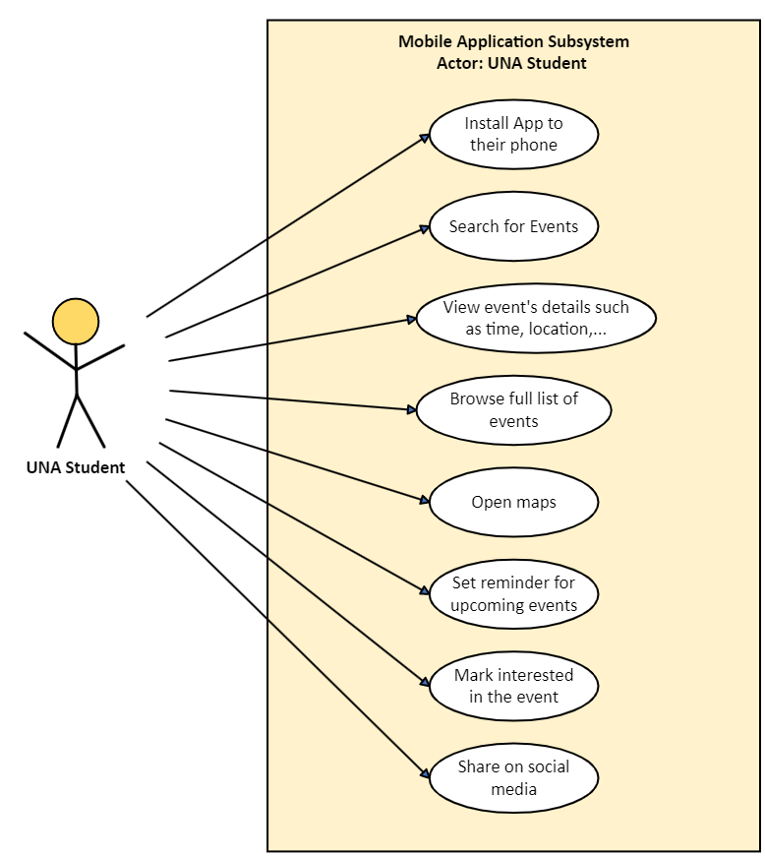
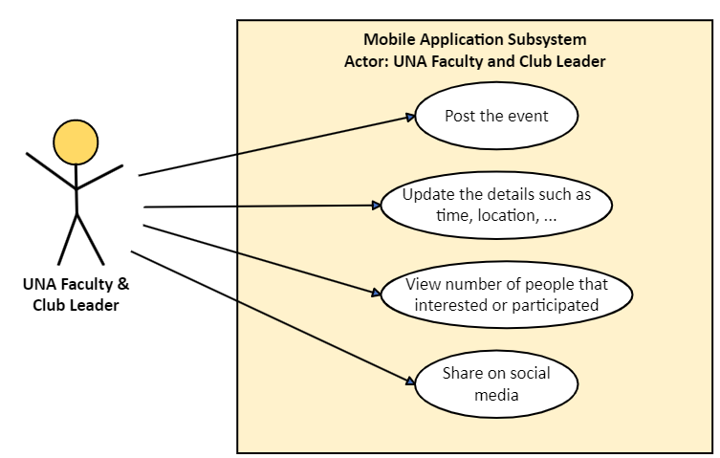
III. Preliminary Design
The preliminary design is based on the Uses Case Diagram as below:

Slide 7
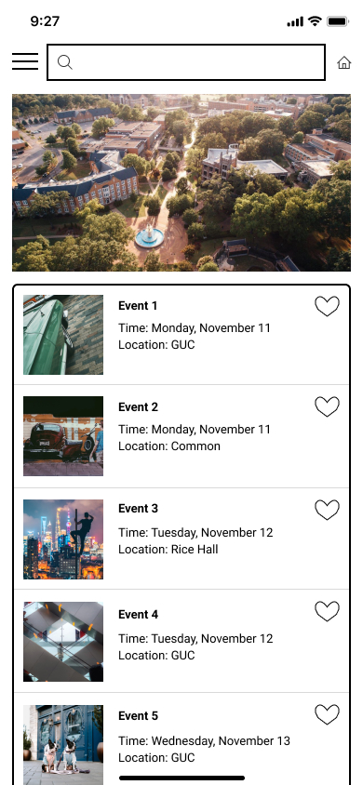
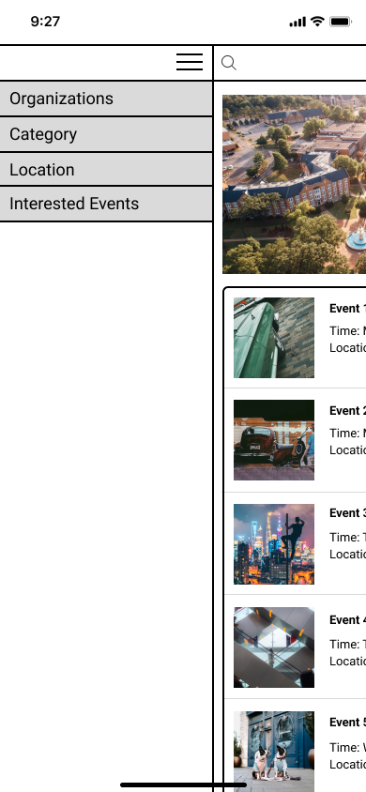
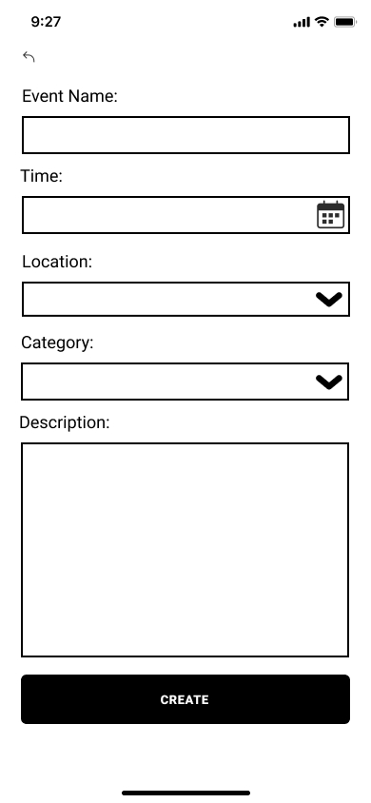
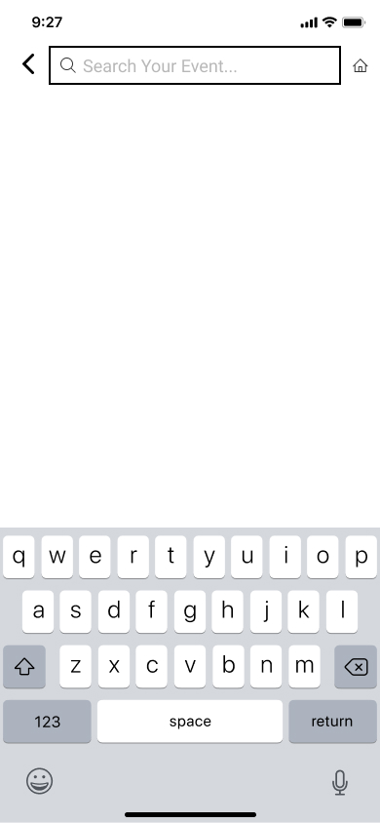
Home
Menu
Create new event
Search event
UNA events app should have some basic functions such as: homepage to show all the upcoming events, menu to filter the event types, create new event, search button, ...

Slide 8
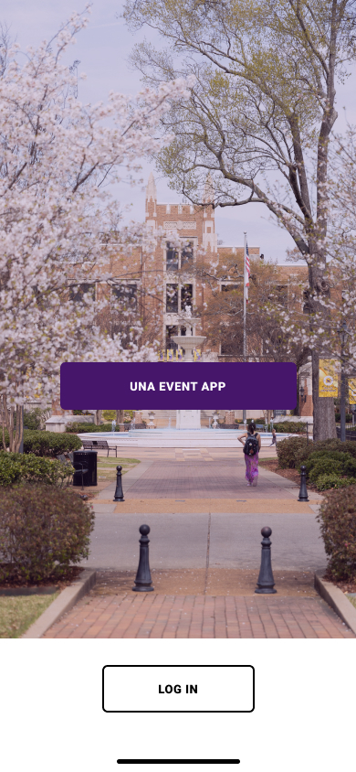
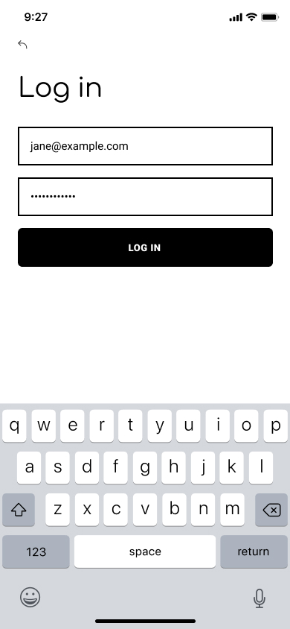
IV. Detailed Design
Login Screen:
The mobile application is connected to the UNA website. UNA students log in with their UNA login credentials and gain access to view upcoming events on campus. Only users with authorization can log onto the app.

Slide 9
Main Menu Screen:
This is the main menu for all users of the application. Users can navigate to several different screens starting here. The home screen presents all upcoming events. The drop-down button in the top left allows users to navigate the app further, such as filtering through organizations and locations.

Slide 10
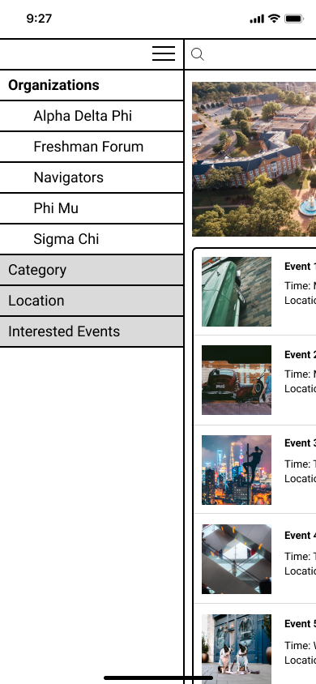
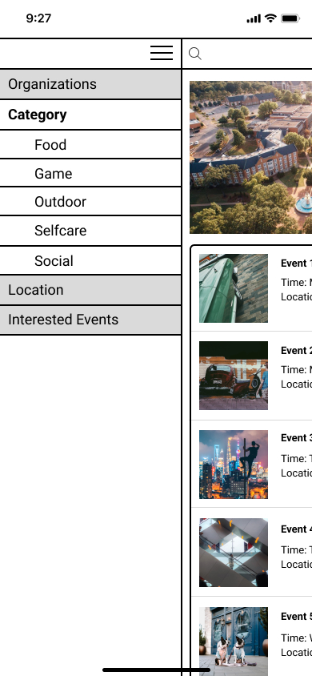
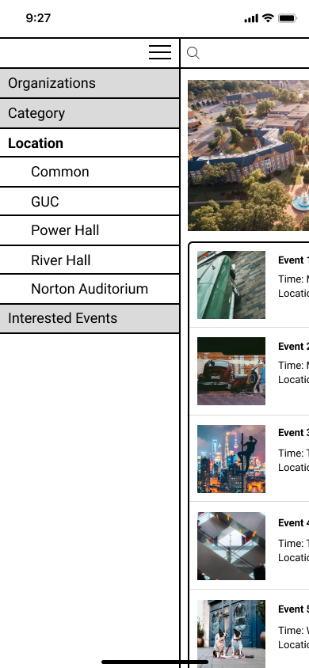
The Drop-Down Button Screen:
In the top left of the home screen is the drop-down button. When the button is pressed a side screen pops up. The user can press and access each of the four buttons that show up. These buttons are, Organizations, Category, Location, and Interested Events. After the buttons are pressed more buttons are opened to be pressed like the organizations and category screens.

Slide 11
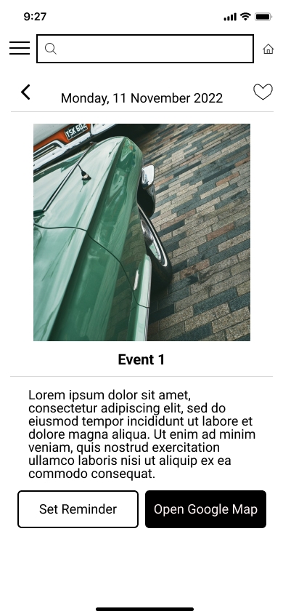
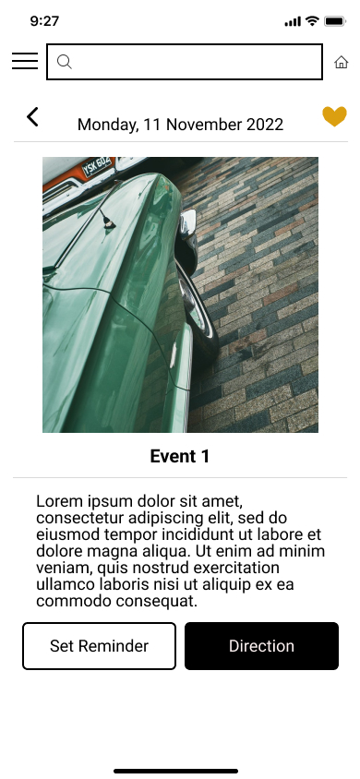
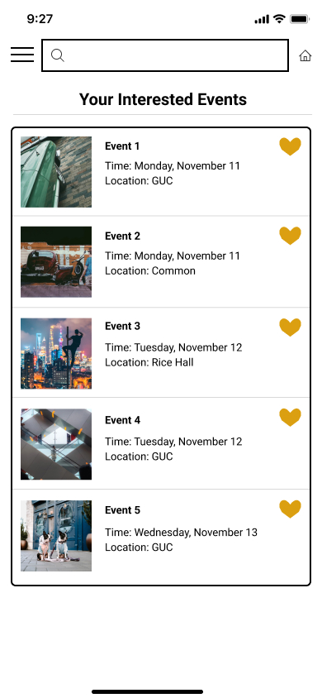
Interested Event:
The users can click the heart symbol to save the event to their interested events list. They can retrieve this list through the drop-down button.

Slide 12
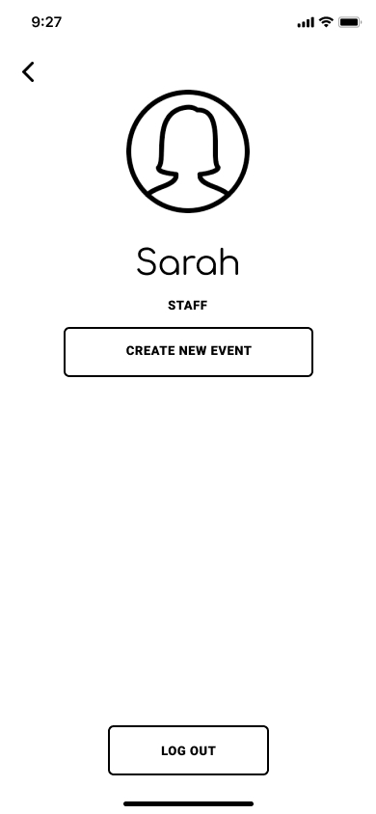
Create Event:
Users have the ability to create new events within the app as well as adding a description, a location, and time for the individual event. An admin then approves or denies their event request before it posts to the app.

Slide 13
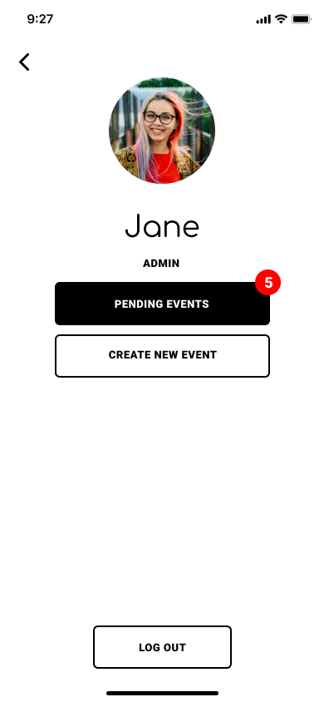
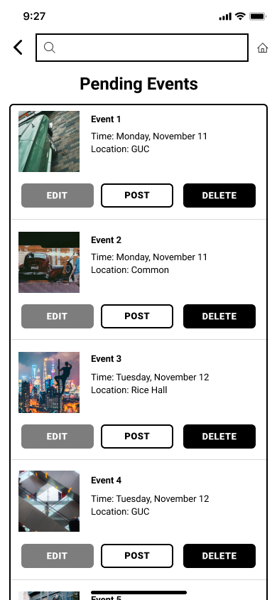
Admin:
This page is only for the staff who have permission to approve proposed events.
In case of error, there are two buttons which can be used for canceling duplicate events and approving or denying upcoming events.

Slide 14
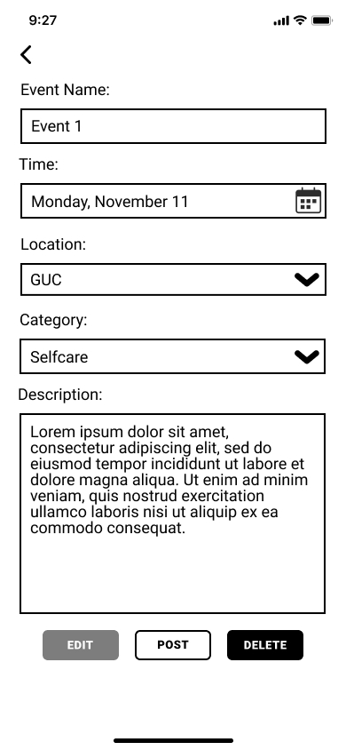
Admin Event Edit:
The select users that have admin privileges will gain access to the edit event function. The edit event function allows for admins to edit individual pieces of information about the event. The edit event function allows for the changing of date, location, etc.

Slide 15
Event Search:
The event search allows for the user to search specific events. Events can be filtered by date or location. It also gives users the ability to save events of interest; saved events can easily be viewed or added to event reminders.

Slide 16
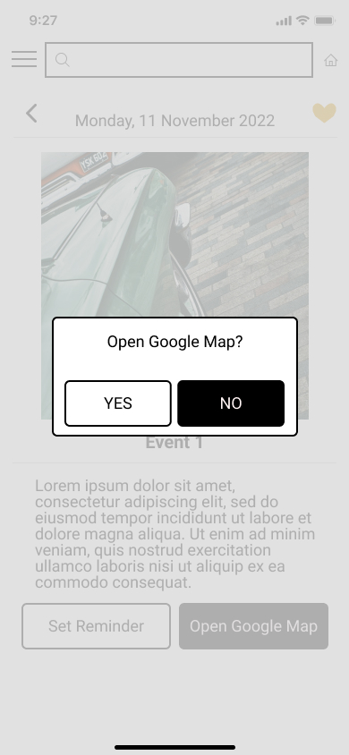

Reminders and Map Function:
The user can set event reminders that auto save to their phone calendar to save the date of upcoming events. The user also can utilize the "map" function to access directions and navigate to event locations.

Slide 17
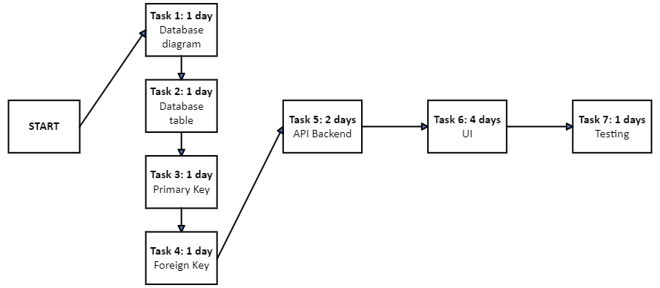
V. Project Management
PERT/CPM Chart:

Slide 18
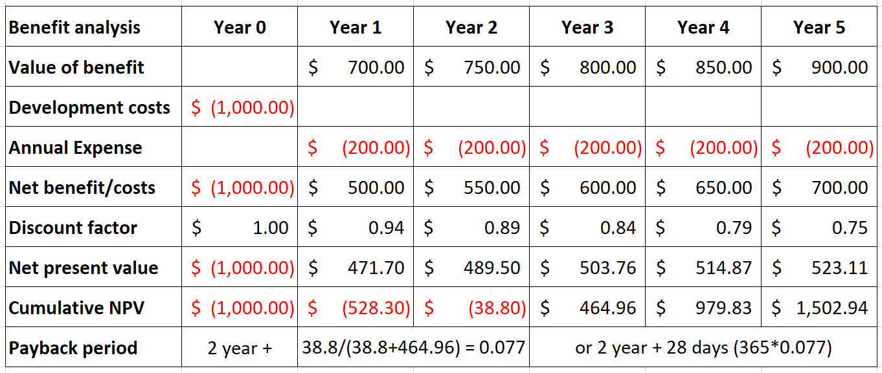
V. Project Management
RMO Cost/Benefit Analysis:

Slide 19
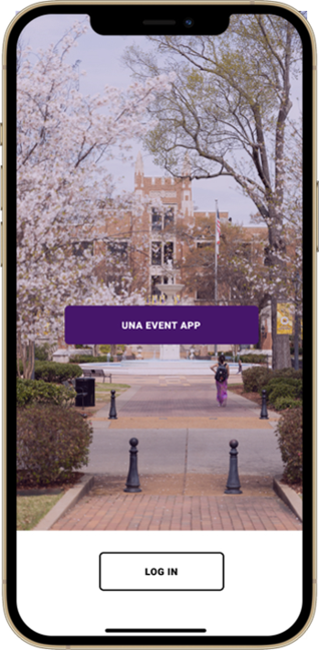
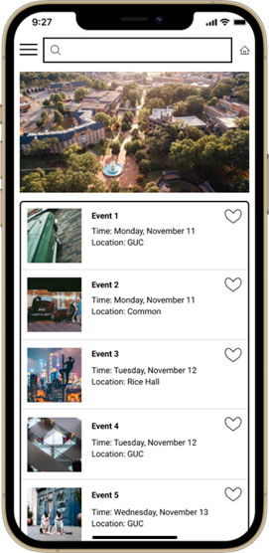
VI. Mockup of Prototype

